Slide 1

Department of Electronics and Communication Engineering
NOISE CANCELLATION IN ECG SIGNAL
Team- A 14
SL NO. | NAME | USN | ROLL NO.
1 | Aksheta B Patel | 02FE22BEC005 | 08
2 | Bhagyashree Jainapur | 02FE22BEC016 | 18
3 | Chandrashekhar Bhavi | 02FE22BEC020 | 21
4 | Pruthviraj Banoshi | 02FE23BEC058 | 56
Under the Guidance of
Dr . Prabhakar Manage

Slide 2
Contents:
Introduction of the need statement.
Identifying multiple solutions with support of technical literature.
Need Analysis and identifying the problem.
Identifying multiple solutions.
Worklet.
Project Planning (Gantt chart) and WBS (Work Breakdown Structure).
Functional Block Diagram.
Detailed block diagram.
Functional Blocks Integration.
Debugging.
Plan for Optimization.
Need for Optimization.

Slide 3
Contents:
Specification and identification of input & output.
Functional block diagram relating input & output, Design specifications.
Implementation.
Present results as a team.

Slide 4
Introduction
• Noise cancellation in ECG signals removes unwanted power line interference or noise, ensuring
accurate heart rate monitoring.
• Noise can distort ECG data, leading to false readings or misinterpretations.
• Sources of noise include movement artifacts, power line interference, and poor electrode contact.
• Important for clinical settings, remote monitoring, and wearable devices to detect cardiovascular
issues.
• Techniques like filtering and adaptive signal processing are used to reduce noise while preserving
heart signal integrity.
• Goal is to enhance ECG data quality for accurate diagnostics and early detection of heart
conditions.

Slide 5
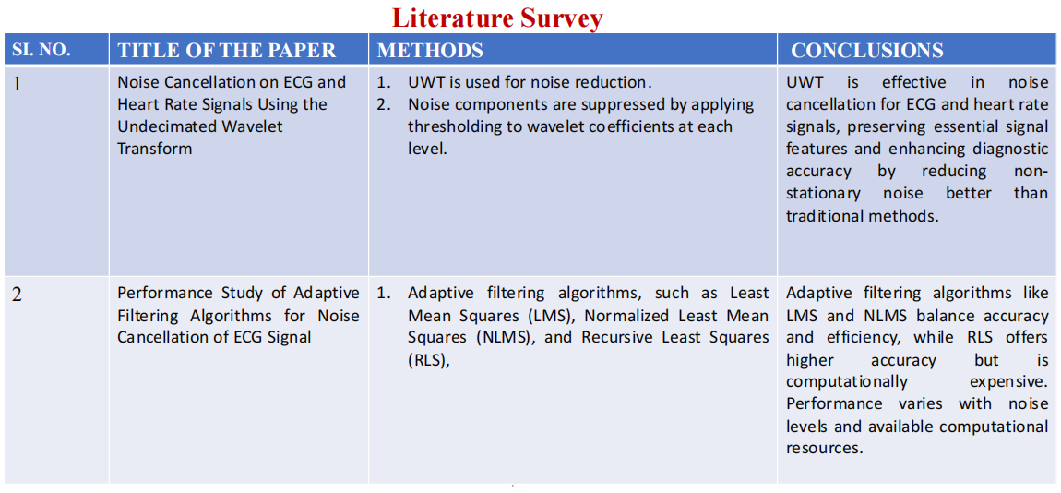

Slide 6
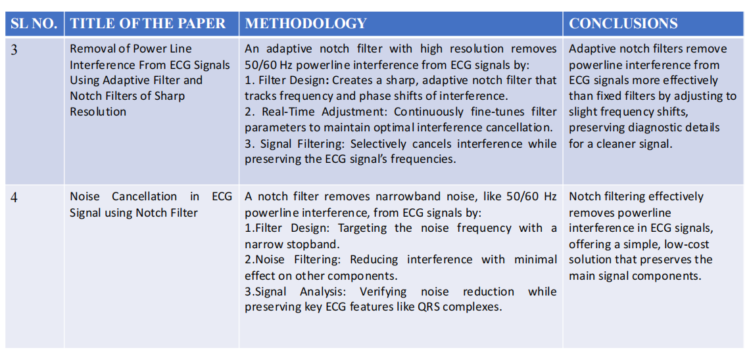

Slide 7
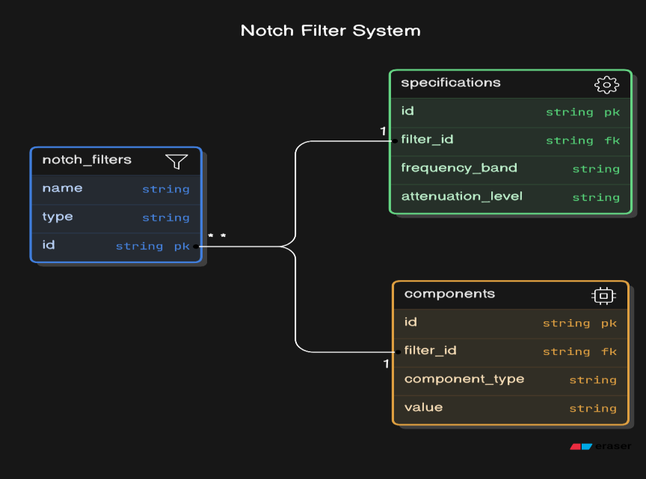
Identifying multiple solutions
“ Adaptive Notch Filter for Power Line Interference Removal in ECG Signals"
A notch filter is used to attenuate specific frequencies, such as 50/60 Hz, to eliminate power
line interference. It allows all other frequencies to pass while sharply reducing the target
frequency

Slide 8
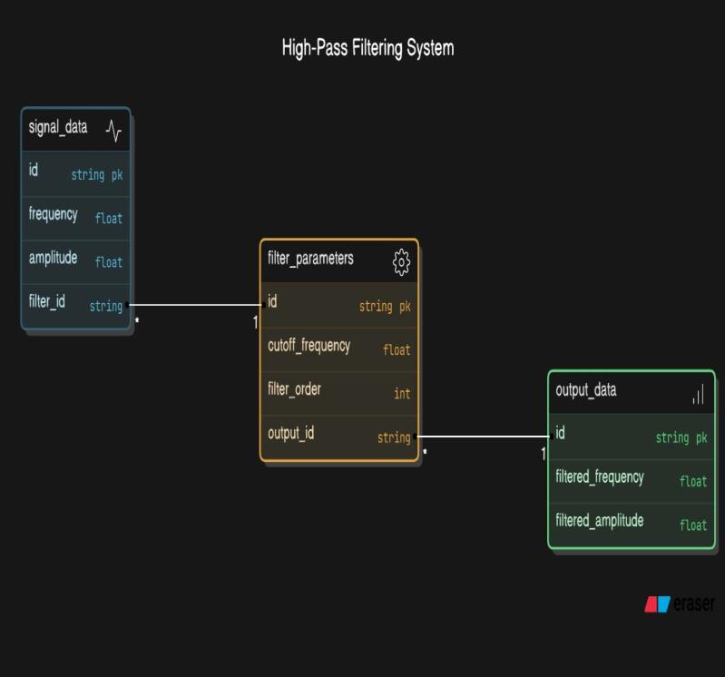
Identifying multiple solutions
"High-Pass Filtering to Eliminate Low-Frequency Components"
High-pass filtering removes low-frequency components from a signal, allowing only
frequencies above a certain cutoff point to pass through. This is useful for eliminating
unwanted noise or drift in the lower frequency range.

Slide 9
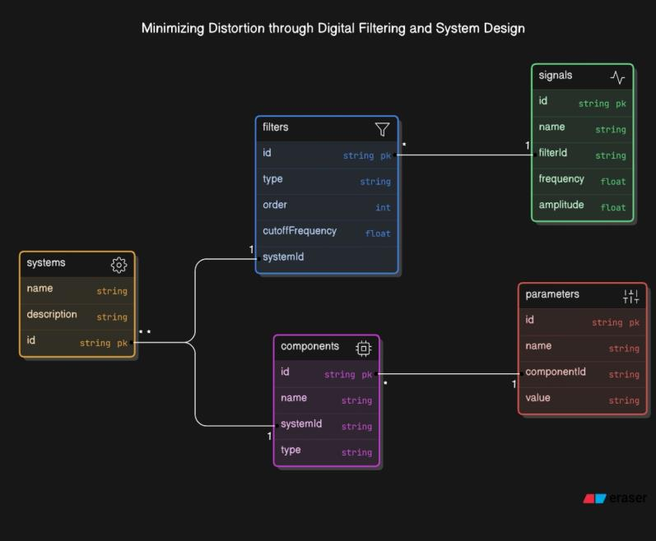
Identifying multiple solutions
"Minimizing Distortion through Digital Filtering and System Design"
Minimizing distortion through digital filtering involves shaping the frequency response to remove
unwanted noise while preserving signal integrity. Proper system design ensures minimal impact on
signal quality and accuracy

Slide 10

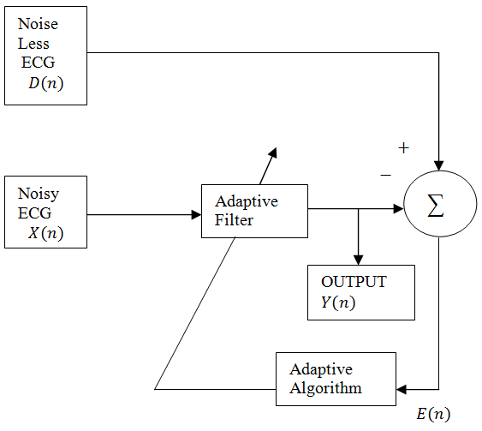
Noise Cancellation in ECG Signal
Context: Noise in ECG signals can obscure essential features, making it challenging to diagnose heart conditions accurately. Developing an effective noise cancellation system improves the clarity of ECG signals, aiding in better diagnosis and analysis.
Block Diagram:
Problem Statement: Build a noise cancellation function for ECG signals that can remove a wide range of noise types without affecting the essential features of the signal.
Deliverables :
Enhanced signal clarity by effectively removing noise.
Validation using diverse and large ECG datasets.
Training / Pre-Requisites
Understanding of Adaptive RLS filters, MATLAB and Filter design.
Drivable
Starter Reference Material
Pan, J., & Tompkins, W. J., 1985. A real-time QRS detection algorithm. IEEE Transactions on Biomedical Engineering, (3), pp. 230-236.
Addison, P. S., 2005. Wavelet transforms and the ECG: A review. Physiological Measurement, 26(5), pp. R155-R199.
Laguna, P., Jané, R., & Caminal, P., 1994. Adaptive filtering of ECG baseline wander. IEEE Engineering in Medicine and Biology Magazine, 11(6), pp. 30-35.
Timeline
Kick Off < 1st Month >
Milestone 1 < 2nd Month >
Milestone 2 < 3rd & 4th Month
Hands-on learning with ECG signal processing and filtering techniques.
Finalizing the filtering technique.
Optimizing the filter parameters.
Testing with large number of dataset.
Documentation.

Slide 11
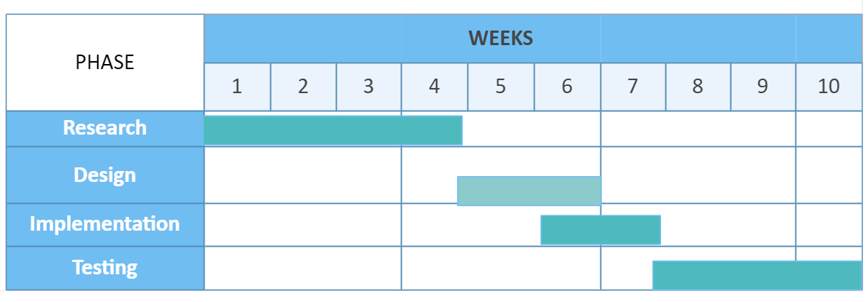
Project Planning

Slide 12
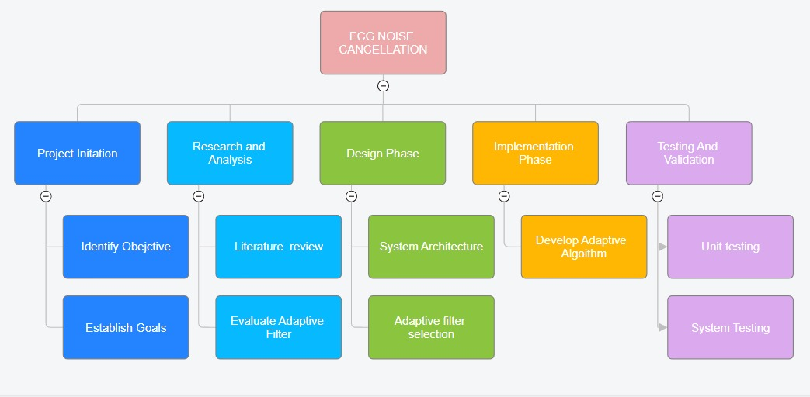
Work Breakdown Structure

Slide 13
Functional Block diagram:
Noise Less ECG
D(n)
Reference Signal
+
Noisy
ECG
X(n)
-
Adaptive Filter
∑
Input signal
OUTPUT​
Y(n)
Adaptive
Algorithm
E(n)

Slide 14
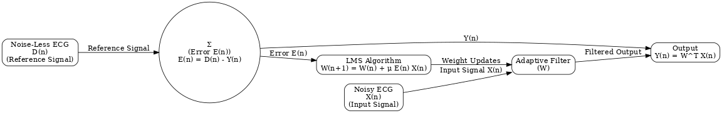
Detailed Block Diagram

Slide 15
Functional Blocks Integration
ECG Signal Block (Primary Input)
This is the clean or noisy ECG signal. Noise can be introduced either by muscle artifacts or power line interference, which needs to be filtered out.
Noise Signal Block
This is typically modeled as some type of random or predefined noise signal like white Gaussian noise or muscle noise superimposed on the ECG signal.
In real scenarios, the noise might be a separate measurement or estimated signal, but in simulation, it’s often synthetic.
Adaptive Filter Block
Input to Adaptive Filter: The filter receives both the noisy ECG signal and the reference noise signal (i.e., the noise itself or a prediction of the noise).
Adaptive Filter Structure: An adaptive filter often uses algorithms like LMS (Least Mean Squares) or RLS (Recursive Least Squares).

Slide 16
Error Signal Block
The error signal is the difference between the filtered output and the original (or expected) clean ECG signal. This is crucial in adaptive filtering as it helps the algorithm adjust its coefficients to improve the filtering process.
Output ECG Signal Block
The filtered ECG signal after noise cancellation. Ideally, this signal is cleaner and closer to the original ECG signal without noise.

Slide 17
Debugging
Input Signal: Validate data by
Plotting the raw ECG signal in the time and frequency domains.
Ensuring correct sampling rates.
Preprocessing: Verify high-pass filter output by
Check for effective removal of baseline drift.
Inspect frequency components to ensure low-frequency noise is reduced.
Adaptive Filter: Debug LMS algorithm:
Monitor filter weights (w(n)w(n)w(n)) over time for stability.
Visualize error signal (e(n)e(n)e(n)) to confirm convergence.
Performance Evaluation: Check SNR improvement:
Compute SNR before and after filtering.
Ensure SNR gain aligns with expectations for the chosen noise level.

Slide 18
Plan for Optimization
Noise Sources: Address powerline interference, baseline wandering, and muscle artifacts.
Preprocessing: Use band-pass filters (e.g., 0.5–50 Hz) to isolate ECG signal frequencies.
Adaptive Filtering: Apply algorithms like LMS (low complexity) or RLS (fast convergence).
Optimization: Dynamic Step Size for adaptive filters.
Combine wavelet transforms for multi-resolution noise removal.
Validation: Test algorithms on standard ECG datasets (e.g., MIT-BIH).

Slide 19
Need for Optimization
Real-Time Monitoring: Enables wearable and portable device functionality.
Telemedicine: Provides reliable remote diagnosis.
Noise Robustness: Handles varying noise in different environments.
Medical Standards: Meets regulatory requirements for signal quality.
Multi-Channel Systems: Synchronizes noise cancellation across ECG leads.
Cost-Effectiveness: Reduces complexity and production costs.
Diagnostic Accuracy: Ensures clear detection of ECG features (P, QRS, T waves).

Slide 20
Specification
INPUT:
Signal Source: Raw ECG data having noise
Noise Types:
Powerline interference (50/60 Hz).
Baseline wander (low-frequency drift due to movement or respiration).
EMG noise (high-frequency artifacts from muscle activity).
Motion artifacts (signal distortion due to electrode displacement).
Sampling Rate: Typically 250 Hz, 500 Hz, or 1 kHz, depending on the system.
Signal Range: Amplitude typically in millivolts (mV)

Slide 21
Specification
OUTPUT:
Cleaned ECG Signal:
Retains critical diagnostic features: P-wave, QRS complex, and T-wave.
Free from significant noise artifacts.
Improved Metrics:
Higher Signal-to-Noise Ratio (SNR).
Preservation of signal morphology for diagnostic accuracy.
Suitability for Analysis:
Usable for automated heart rate variability (HRV) analysis.
Reliable for arrhythmia and other cardiac condition diagnostics.

Slide 22
Identification
INPUT:
Noisy ECG Signal: Collected via surface electrodes, contains powerline interference, baseline wander, EMG noise, and motion artifacts.
Amplitude Range: Millivolts (mV).
Sampling Rate: 250 Hz, 500 Hz, or 1 kHz.
OUTPUT:
Denoised ECG Signal: Preserved P-wave, QRS complex, T-wave; significantly reduced noise.
Metrics: Improved SNR, suitable for arrhythmia detection and HRV analysis.

Slide 23
Block diagram:
Noise Less ECG
D(n)
Reference Signal
+
Noisy
ECG
X(n)
-
Adaptive Filter
∑
Input signal
OUTPUT​
Y(n)
Adaptive
Algorithm
E(n)

Slide 24
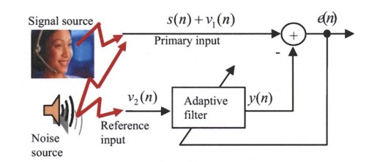
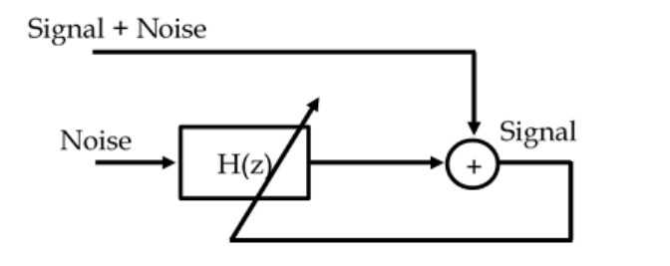
Block Diagram of Adaptive noise cancellation using
reference input (noise)
Diagram of an interference cancelling problem

Slide 25
Design Specifications
a) Objective:
To design an adaptive filter using the Normalized Least Mean Squares (NLMS) algorithm to minimize noise and improve the Signal-to-Noise Ratio (SNR) of a given primary signal using a reference input.
b) Input Signals:
Primary Signal: The desired signal with noise.
Reference Signal: An input used to model the noise present in the primary signal.
c) Filter Specifications:
Filter Type: Adaptive filter.
Algorithm: Normalized Least Mean Squares (NLMS).
Filter Order: 30 (Number of taps).

Slide 26
Implementation
Adaptive filter code :
1. Load Data:
Read the input data from sample_data.mat file
Extract the primary signal (desired output) and the reference signal (input to the filter).
2. Initialize Parameters:
Set the filter order (e.g., 30), step size (Nu = 0.05), and a small constant (Epsilon = 0.0001).
Initialize the filter weights (W_1 and W_2) to zeros.
3. Prepare Filter Input:
Truncate the primary signal to account for filter delay.
Create a matrix (reference_wrt_filter) where each row contains the past samples of the reference signal, matching the filter order.

Slide 27
4. Adapt the Filter Loop through the data:
Compute the error:
Difference between the desired signal (primary) and the filtered output of the reference signal.
Calculate the Mean Squared Error (MSE) at each iteration to monitor performance.
5. Divide the Data Process in two segments:
First segment (1–46,500 samples): Update W_1 and compute performance_curve1.
Second segment (46,501–end): Update W_2 and compute performance_curve2.
6. Output the Results:
Combine the error signals from both segments.
Compute the Signal-to-Noise Ratio (SNR) improvement after filtering.
Plot:
Learning Curves: MSE vs. iterations for both segments.
Error Signal: Difference between the desired output and filtered output.
7. Optional Step:
Use the sounds function to play back the filtered signal.

Slide 28
Sample Results /Expected Output:
1. Learning Curves
Graph 1: The MSE (error) reduces as the filter learns over the first 46,500 data points.
The line starts high and then gradually decreases, showing the filter is improving.
Graph 2: The same process but for the later data points (46,501 onwards).
The line might be stable or decrease further depending on the signal.
2. Error Signal
Graph 3: A plot of the remaining noise/error after the filter is applied.
Ideally, this should be small, meaning the filter has done a good job of removing noise.
3. Signal-to-Noise Ratio (SNR)
You will see a number printed like:
java
Copy code
SNR After = 20 dB
A higher number (e.g., 20 dB or more) means the signal quality improved after filtering.
4. Audio Output (Optional)
If you play the sound, it will be a cleaner version of the original signal with less noise.

Slide 29
THANK YOU

